Slide 1
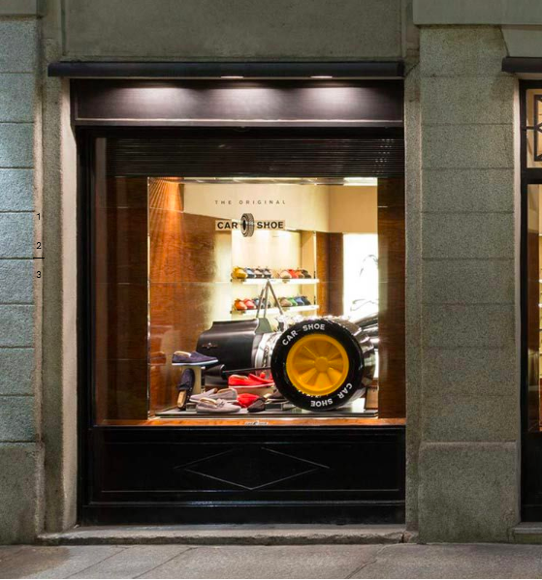


Prada Spa vs. kering
By: Isha Sinha
Notes:
Overview
Commonalities
Materiality & the EP&L
Resilience analysis

Slide 2
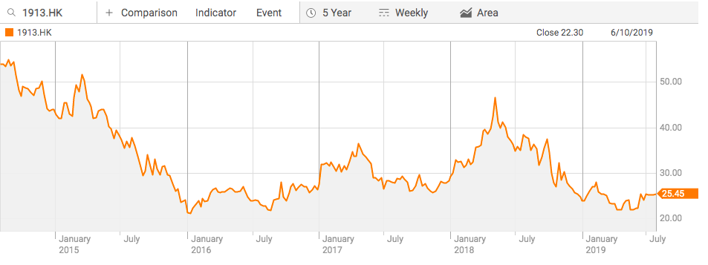
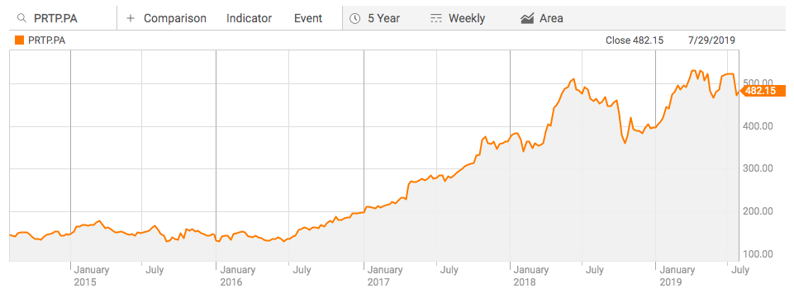
Overview
PRADA
KERING
Established in 1913
Headquarters: Milan, Italy
Stock: 1913.HK
6 years of sustainability reporting ✅
GRI compliant ✅
Stakeholder engagement & materiality ✅
Targets:
  Convert all virgin nylon to Re-Nylon by the end of 2021
  Further industrial investments to make the workplace more safe
Established in 1963
Headquarters: Paris, France
Stock: KER (EPA)
6 years of sustainability reporting ✅
Does not follow GRI standards – they instead have their own reporting mechanism called EP&L
Targets:
  Reduce the intensity of its overall EP&L account by 40% by 2025
  Support the continuation of craftsmanship training
  Amplify forward thinking employment practices
Notes:
Both are in the fashion and luxury goods industry
They both have done a materiality analysis & stakeholder engagement
They say They are able to measure and quantify the environmental impact of the activities.

Slide 3
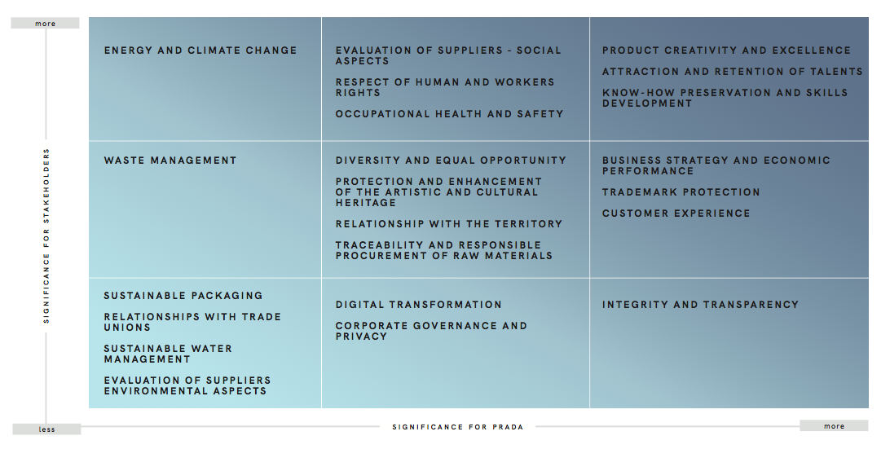
PRADA’S MATERIALITY ASSESSMENT

Slide 4
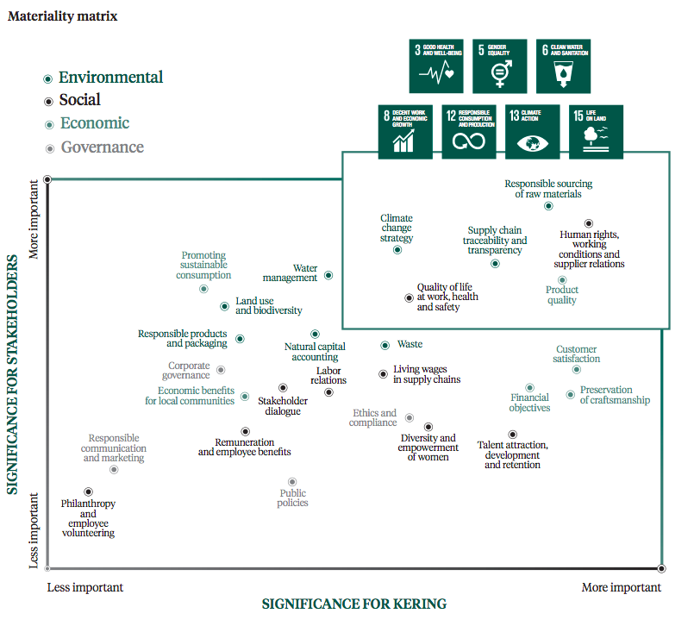
KERING’S MATERIALITY ASSESSMENT

Slide 5
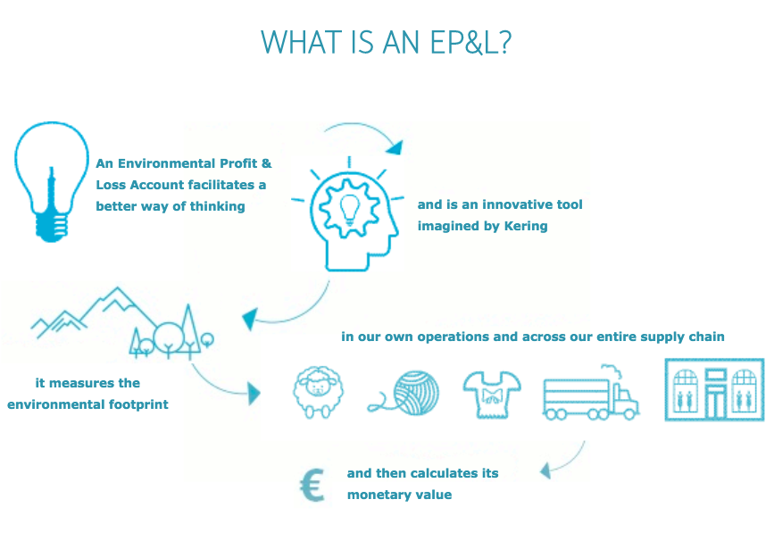
Environmental Profit & Loss
KERING SUSTAINABILITY REPORTING MEHANISM
WHY?
Understand where impacts are
Develop a knowledgeable decision making process
Strengthen our business and manage risks for the future
Be transparent with stakeholders
Steer our business strategy responsibly

Slide 6
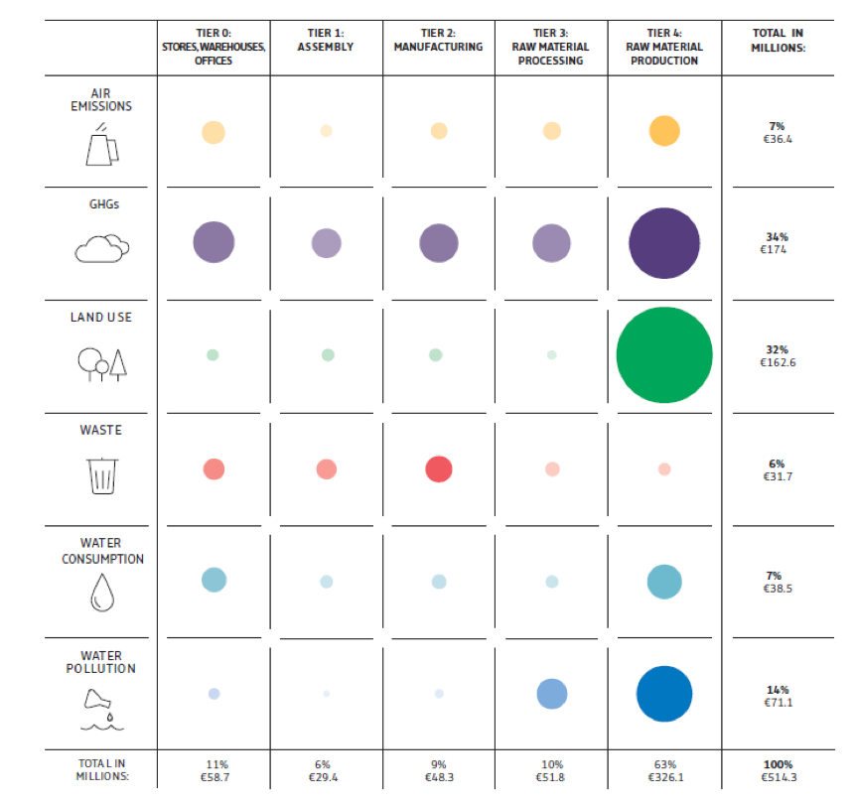
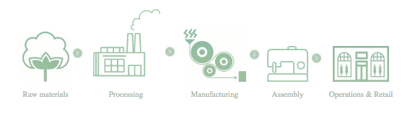
HOW THEY MEASURE:
To measure their true environmental impact they examine the following across their value chain:
Carbon emissions
Water Use
Water Pollution
Land use
Air pollution
Waste
2018 EP&L RESULTS
Notes:
They analyze these factors through their value chain in order to really understand their impact.
They try to calculate the monetary value of this impact but I am not too sure how exactly they do this

Slide 7
GRI vs. EP&L
GRI (PRADA) | SIMILARITIES | EP&L (KERING)
Economic Factors Environmental Aspects Social | Materiality Assessment Governance Structure Information On Employees Stakeholder engagement Key Targets Gender Diversity | Scale of Impact From Each Point In The Value Chain
Notes:
Key targets – although kering’s targets were far more comprehensive and timely

Slide 8
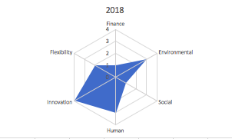
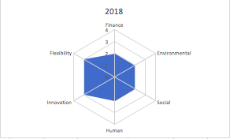
Prada
kering
2018 Data:
Materiality - 3
Targets - 3
Delivery - 2
Innovation - 4
Flexibility - 2
SCORE:
2015: 9/20
2017: 10/20
2018: 14/20
2018 Data:
Materiality - 3
Targets - 4
Delivery - 1
Innovation - 3
Flexibility - 3
SCORE:
2015: 10/20
2017: 10/20
2018: 14/20
Notes:
Even though one company follows a specific sustainability measuring mechanism, it is possible that in fact another company is in fact more sustainable and is even doing better financially and so I think even though this is v1 of the resilience, I do feel that some exceptions or fine-tuning can be made to the framework so that such companies are not missed out on

